Slide 2
ESNEK HAVA KANALLARI /
FLEXIBLE AIR DUCTS
FANLAR /
FANS
MONTAJ ELEMANLARI /
MONTAGE ELEMENTS
ISI GERİ KAZANIM CİHAZLARI /
HEAT RECOVERY UNITS
ANEMOSTAD VE PANJURLAR /
VENTILATION EQUIPMENTS
HAVA PERDELERİ /
AIR CURTAINS
ENDÜSTRİYEL HORTUMLAR /
INDUSTRIAL HOSES
TEKSTİL HAVA KANALLARI

Slide 3
ANEMOSTAD VE PANJURLAR /
VENTILATION EQUIPMENTS
2010

Slide 4
PLASTİK HAMMADDE
PLASTIC MATERIAL
ABS
(Acrylonitrile Butadiene Styrene)
ABS
Antişok
(High Impact Polystyrene)
HIPS
Moblen
(Polypropylene)
PP
RENK PİGMENTİ
COLOR PIGMENT
DİĞER KATKI MALZEMELERİ
OTHER ADDITIVE MATERIALS

Slide 5
ABS MALZEME ÖZELLİKLERİ / ABS MATERIAL PROPERTIES
ÖZELLİKLER / PROPERTIES | DEĞER / VALUE | YORUMLAR / COMMENTS
Density | 0.882 - 3.50 g/cc | Average value: 1.06 g/cc Grade Count:426
Hardness, Rockwell R | 90,0 - 119 | Average value: 108 Grade Count:254
Tensile Strength, Ultimate | 12.7 - 73.1 MPa | Average value: 38.5 MPa Grade Count:170
 | 20.0 - 52.0 MPa @Temperature -18.0 - 90.0 °C | Average value: 35.8 MPa Grade Count:3
Thermal Conductivity | 0.128 - 0.200 W/m-K | Average value: 0.176 W/m-K Grade Count:19
Maximum Service Temperature, Air | 77.0 - 109 °C | Average value: 93.2 °C Grade Count:12
Glass Transition Temp, Tg | 105 - 109 °C | Average value: 107 °C Grade Count:9
Heat Distortion Temperature | 85.0 - 86.1 °C | Average value: 85.3 °C Grade Count:4
Processing Temperature | 177 - 232 °C | Average value: 207 °C Grade Count:15
Nozzle Temperature | 191 - 274 °C | Average value: 224 °C Grade Count:70
Mold Temperature | 10.0 - 90.0 °C | Average value: 57.9 °C Grade Count:158
http://www.matweb.com/search/DataSheet.aspx?MatGUID=eb7a78f5948d481c9493a67f0d089646

Slide 6
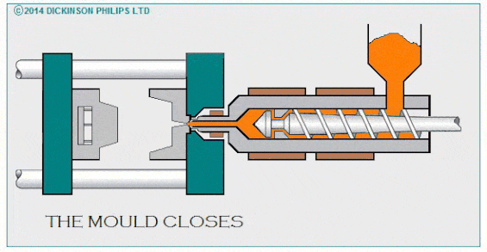
PLASTİK ENJEKSİYON KALIPLAMA / PLASTIC INJECTION MOLDING

Slide 7
PLASTİK ÜRÜNLER
PLASTIC PRODUCTS
ANEMOSTADLAR
PANJURLAR
DİĞER PLASTİK ÜRÜNLER
AIR DISC VALVE
GRILLS
OTHER PLASTIC EQUIPMENTS

Slide 8
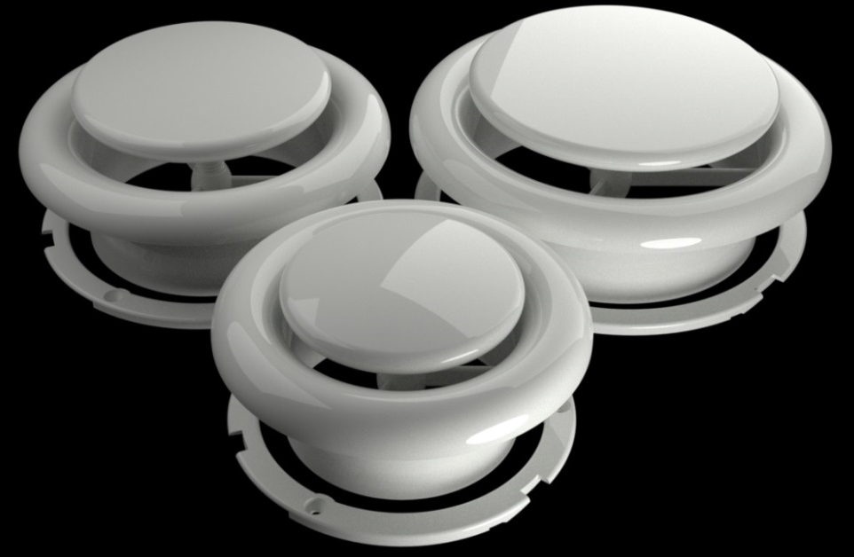
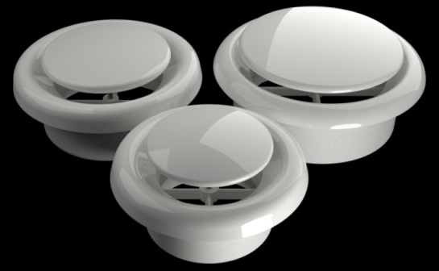
ANEMOSTADLAR
AIR DISC VALVES
Smart Anemostad
P Smart
Air Disc Valve
Plastik Gemici Anemostad
Yuvarlak Plastik Anemostad
Plastic Air Disc Valve
Round Ceiling Diffusor

Slide 9
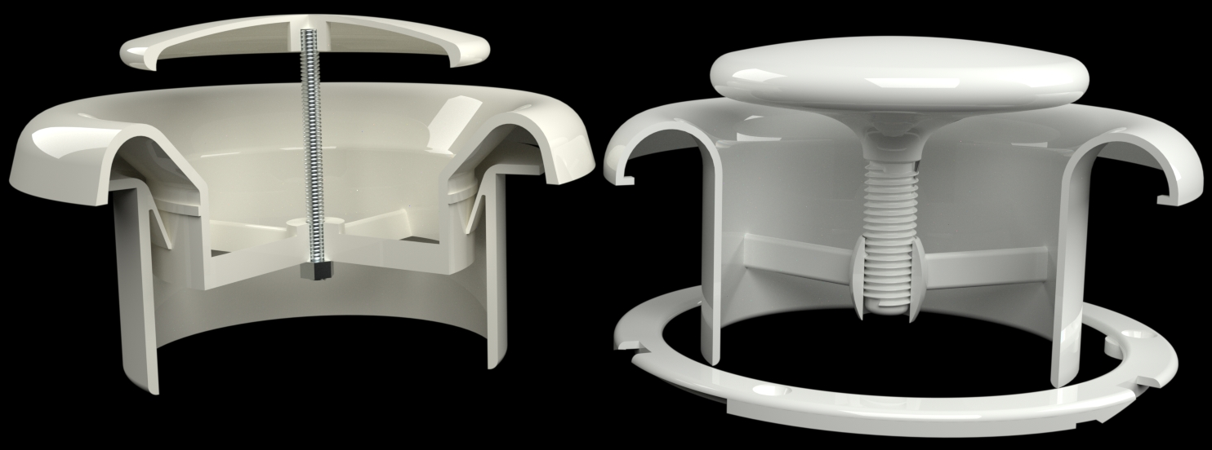
ANEMOSTADLAR
AIR DISC VALVES
Düşük basınç kaybı
Üfleme ve emişe uygun tasarım
Paslanmaz
Hızlı montaj
Daha iyi iç ortam hava kalitesi
Sabit akış
Minimum pressure loss
Innovative design for exhaust and supply
No corrosion
Quick Mounting
Better indoor air quality
Constant flow

Slide 10
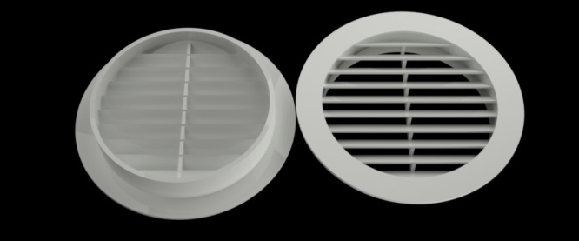
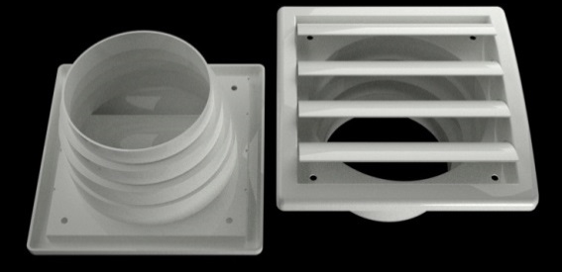
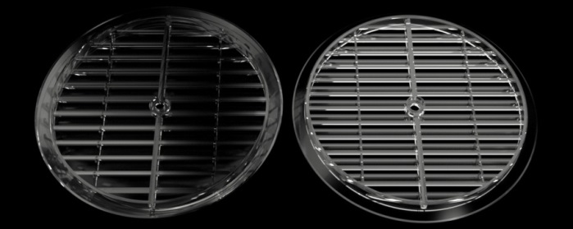
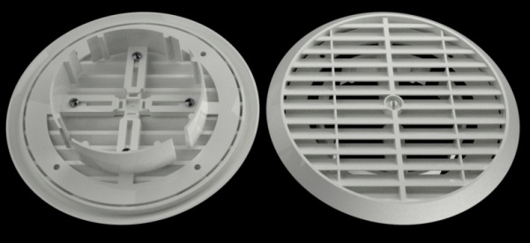
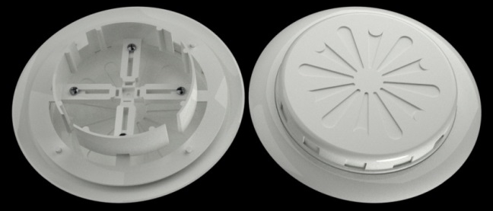
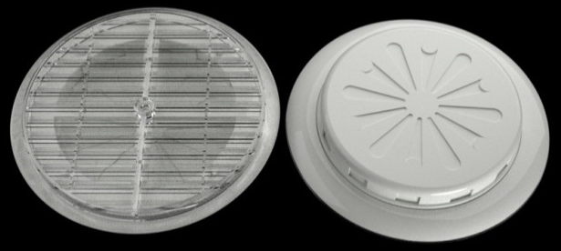
PANJURLAR
GRILLS
Raksan 014
Raksan 025
Conair 006
Conair 025
Raksan 005
Raksan 020
Conair 010
Conair 008
UFO 01
UFO 02
Conair 009
Conair 011

Slide 11
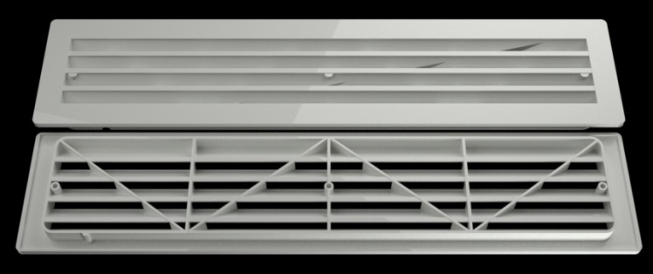
PANJURLAR
GRILLS
TRANSFER MENFEZLERİ
TRANSFER GRILLS
Raksan 016
Raksan 017
Raksan 018
Raksan 019
Conair 015
Conair 016
Conair 017
Conair 018
KAPI TRANSFER MENFEZLERİ
DOOR TRANSFER GRILLS
Raksan 008A
Raksan 008B
Conair 020
Conair 019

Slide 12
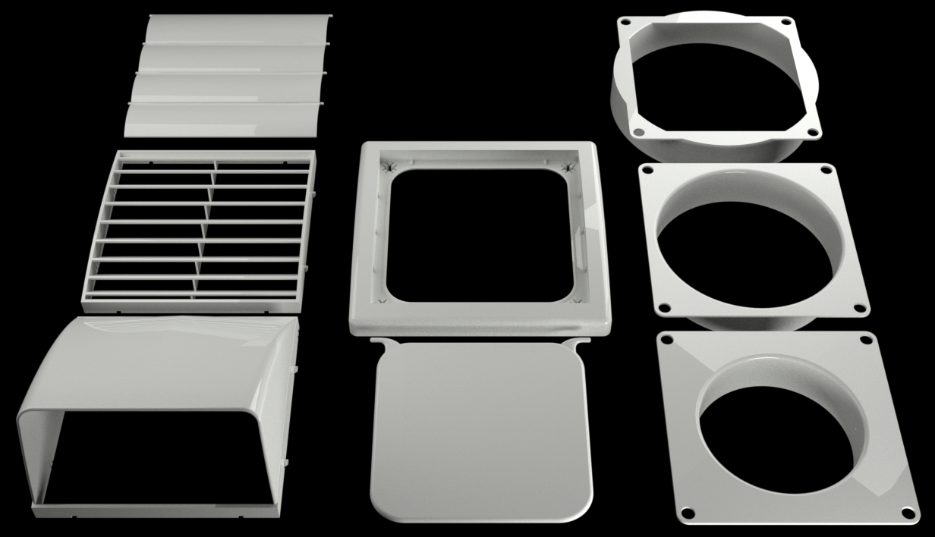
PANJURLAR
GRILLS
SMART PANJUR SERİSİ
SMART GRILLS

Slide 13
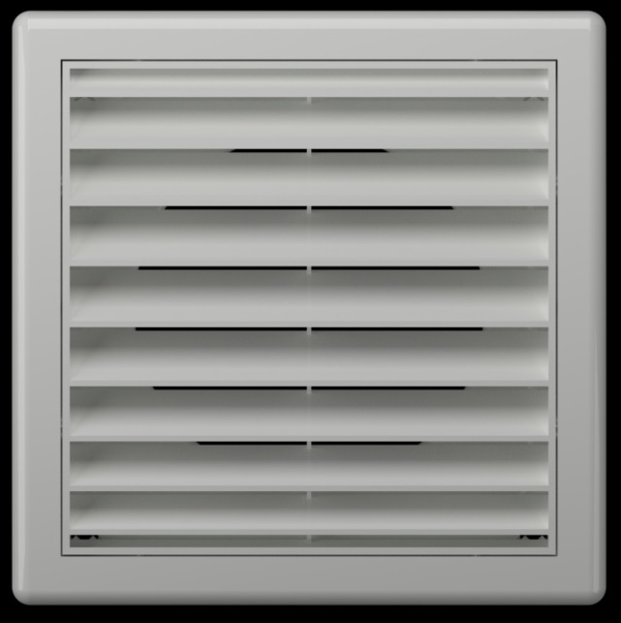
PANJURLAR
GRILLS
SMART PANJUR SERİSİ
SMART GRILLS
Raksan 040 / Conair 1040
Raksan 044 / Conair 1044
Raksan 048 / Conair 1048
Raksan 041 / Conair 1041
Raksan 045 / Conair 1045
Raksan 049 / Conair 1049
Raksan 042 / Conair 1042
Raksan 046 / Conair 1046
Raksan 050 / Conair 1050
Raksan 043 / Conair 1043
Raksan 047 / Conair 1047
Raksan 051 / Conair 1051

Slide 14
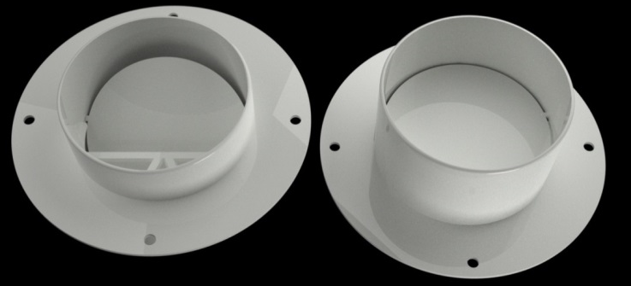
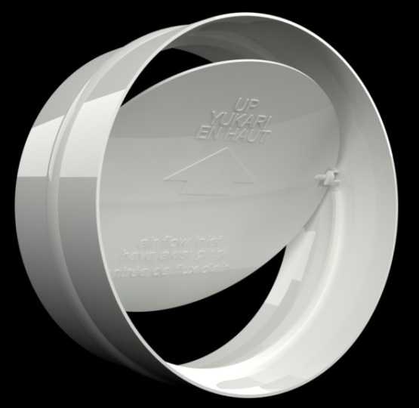
DİĞER PLASTİK ÜRÜNLER
OTHER PLASTIC EQUIPMENTS
PLASTİK GERİ DÖNÜŞ KLAPESİ
PLASTIC BACK DROUGHT SHUTTERS
Raksan 060
Raksan 056
Conair 060
Conair 056
Raksan 061
Conair 061

Slide 15
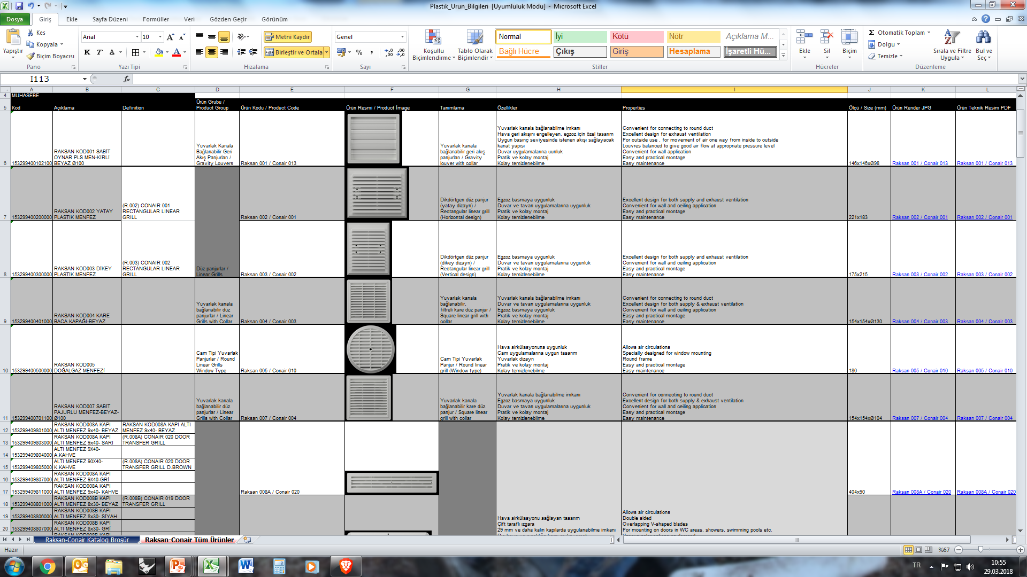
PLASTİK ÜRÜN BİLGİLERİ
SERTİFİKALAR (T):\Yurtiçi Satış/Yurtdışı Satış\02 PLASTİK ANEMOSTAD ve PANJURLAR\Plastik_Urun_Bilgileri

Slide 16
TEŞEKKÜRLER

